Slide 1
Flick!
What has Flick been getting up to in lockdown?

Slide 2
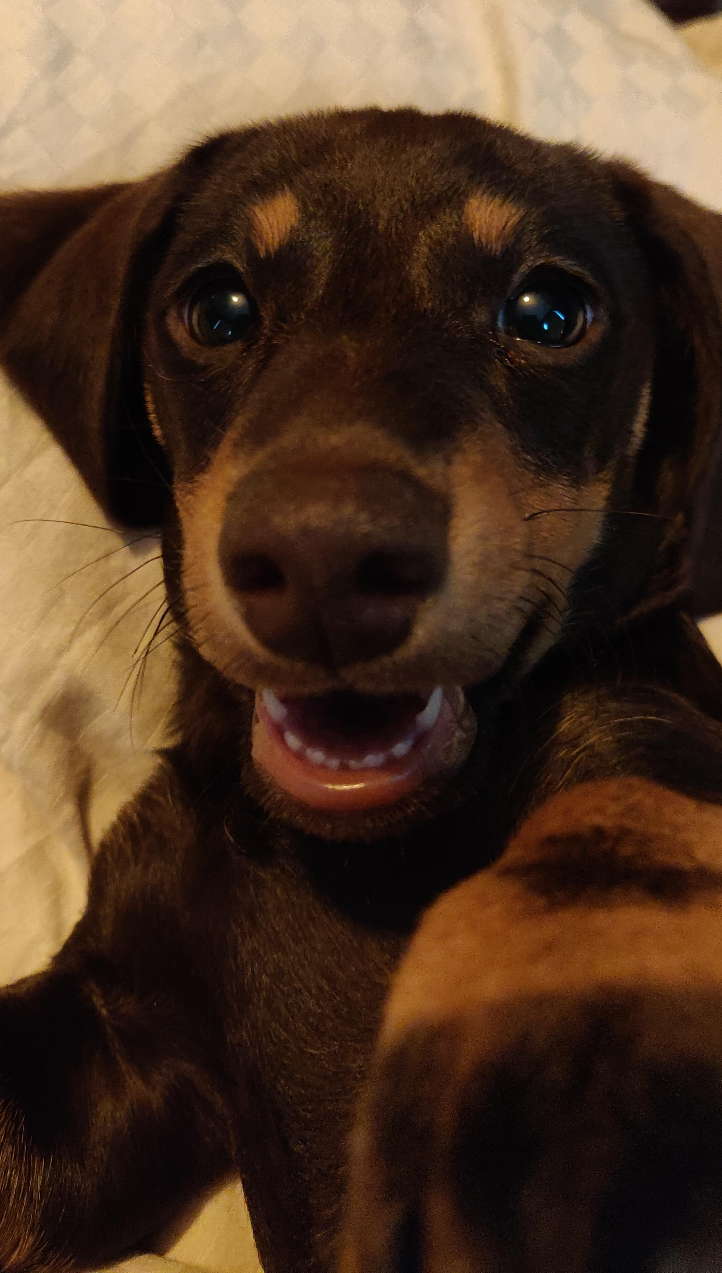
Hi guys!
I’m missing seeing you all at school! I’ve been a busy puppy though – running around, playing fetch, barking when I wedge my ball underneath cupboards and sofas…it’s tiring stuff!
Here are a few snaps of my lockdown adventures so far.
See you soon, Flick xx

Slide 3
I’ve been leaping over the long grass on the fields next to my house. I’m learning to check how deep puddles are before I jump in them…I went in one and was wet up to my neck!

Slide 4
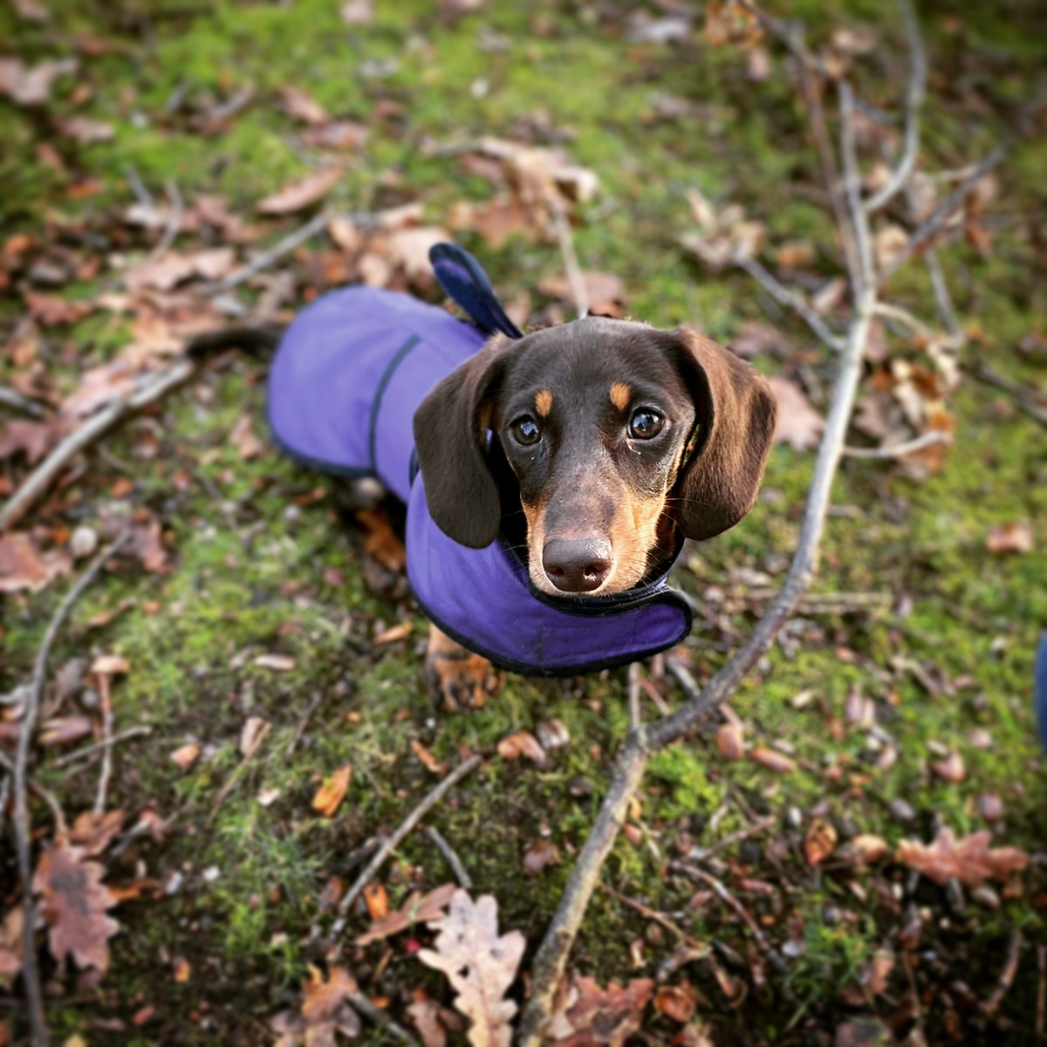
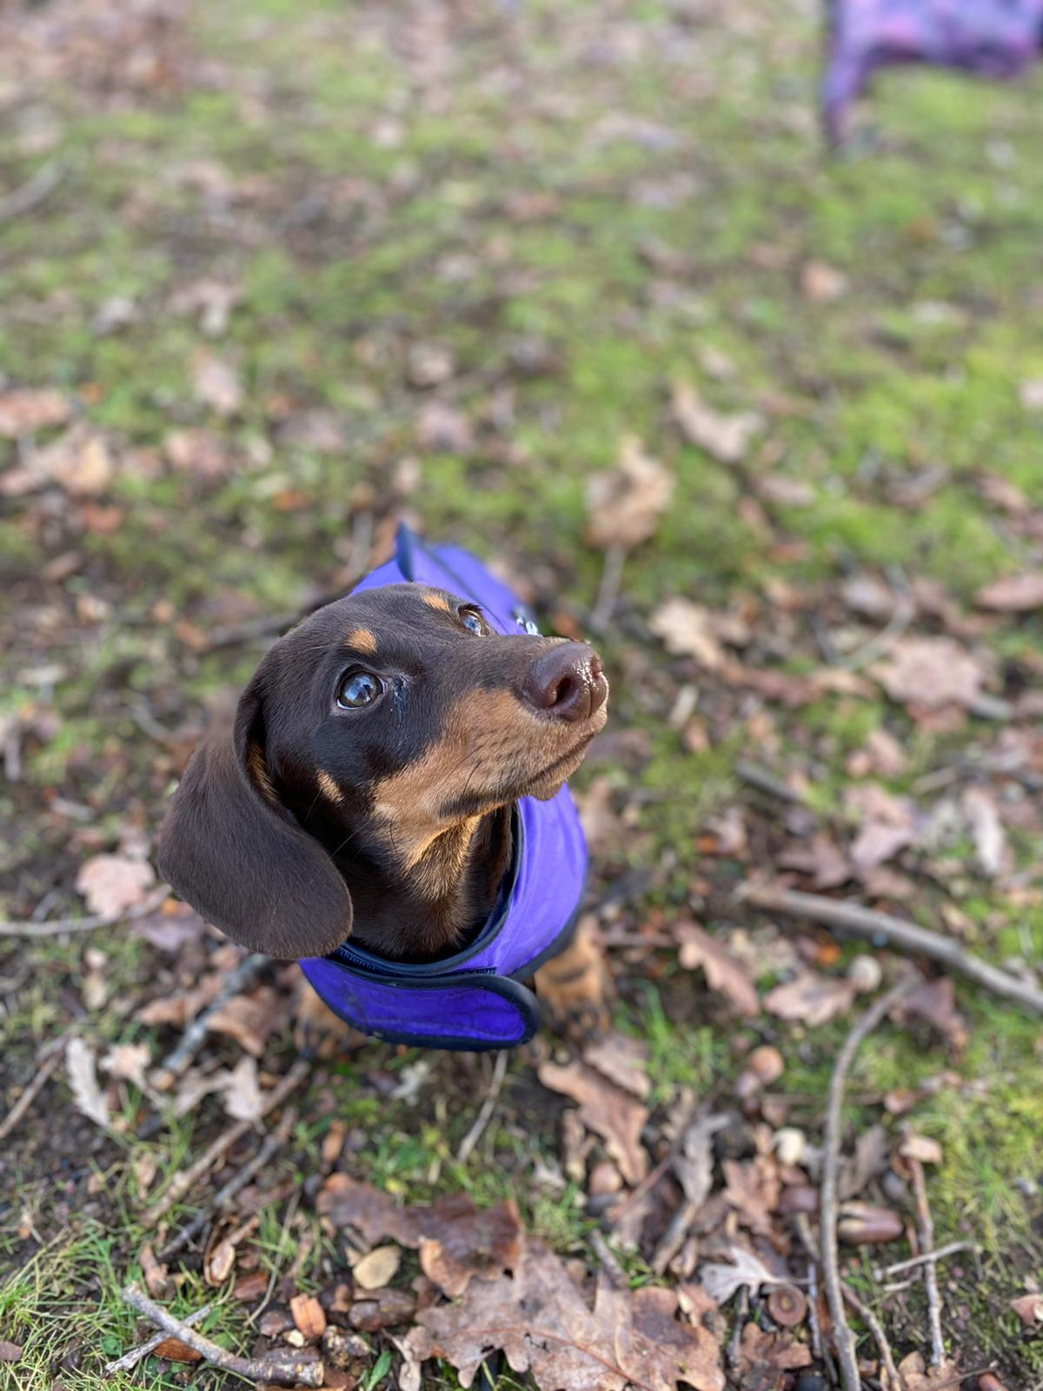
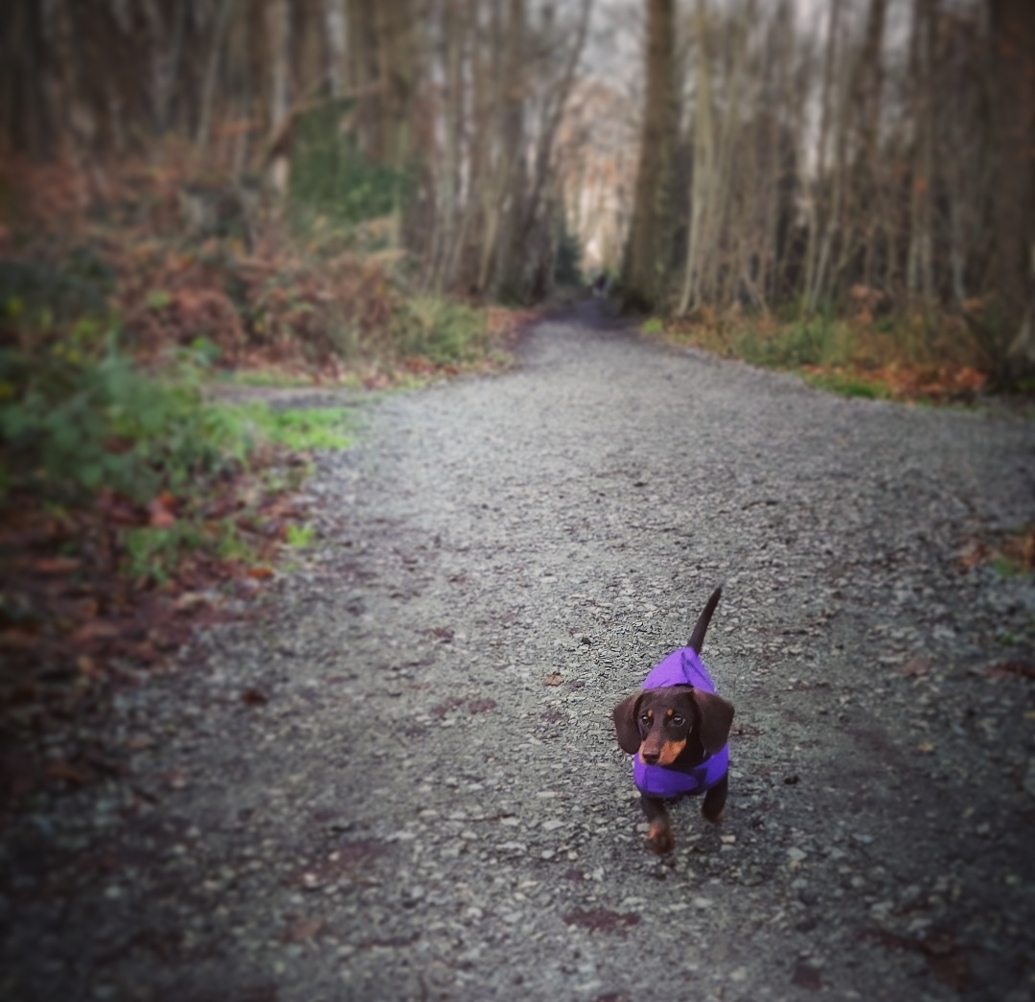
I’ve explored the woods, which were very muddy!
Luckily I have a new coat…do you like it?

Slide 5
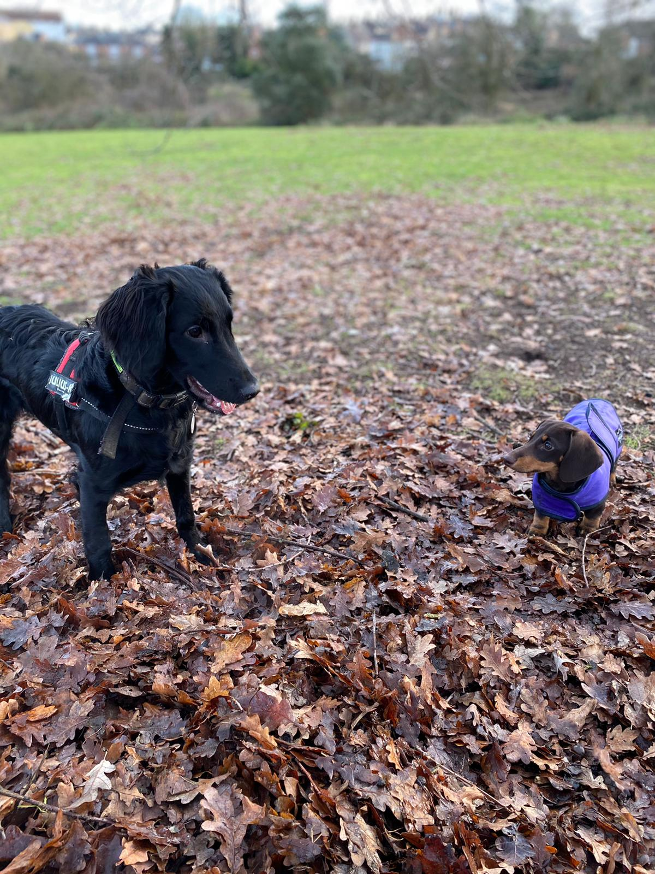
This is my best pal Solar. We went for a socially distanced walk and she showed me how to dig in the leaves. She’s a bit older than me so teaches me all the best tricks.

Slide 6
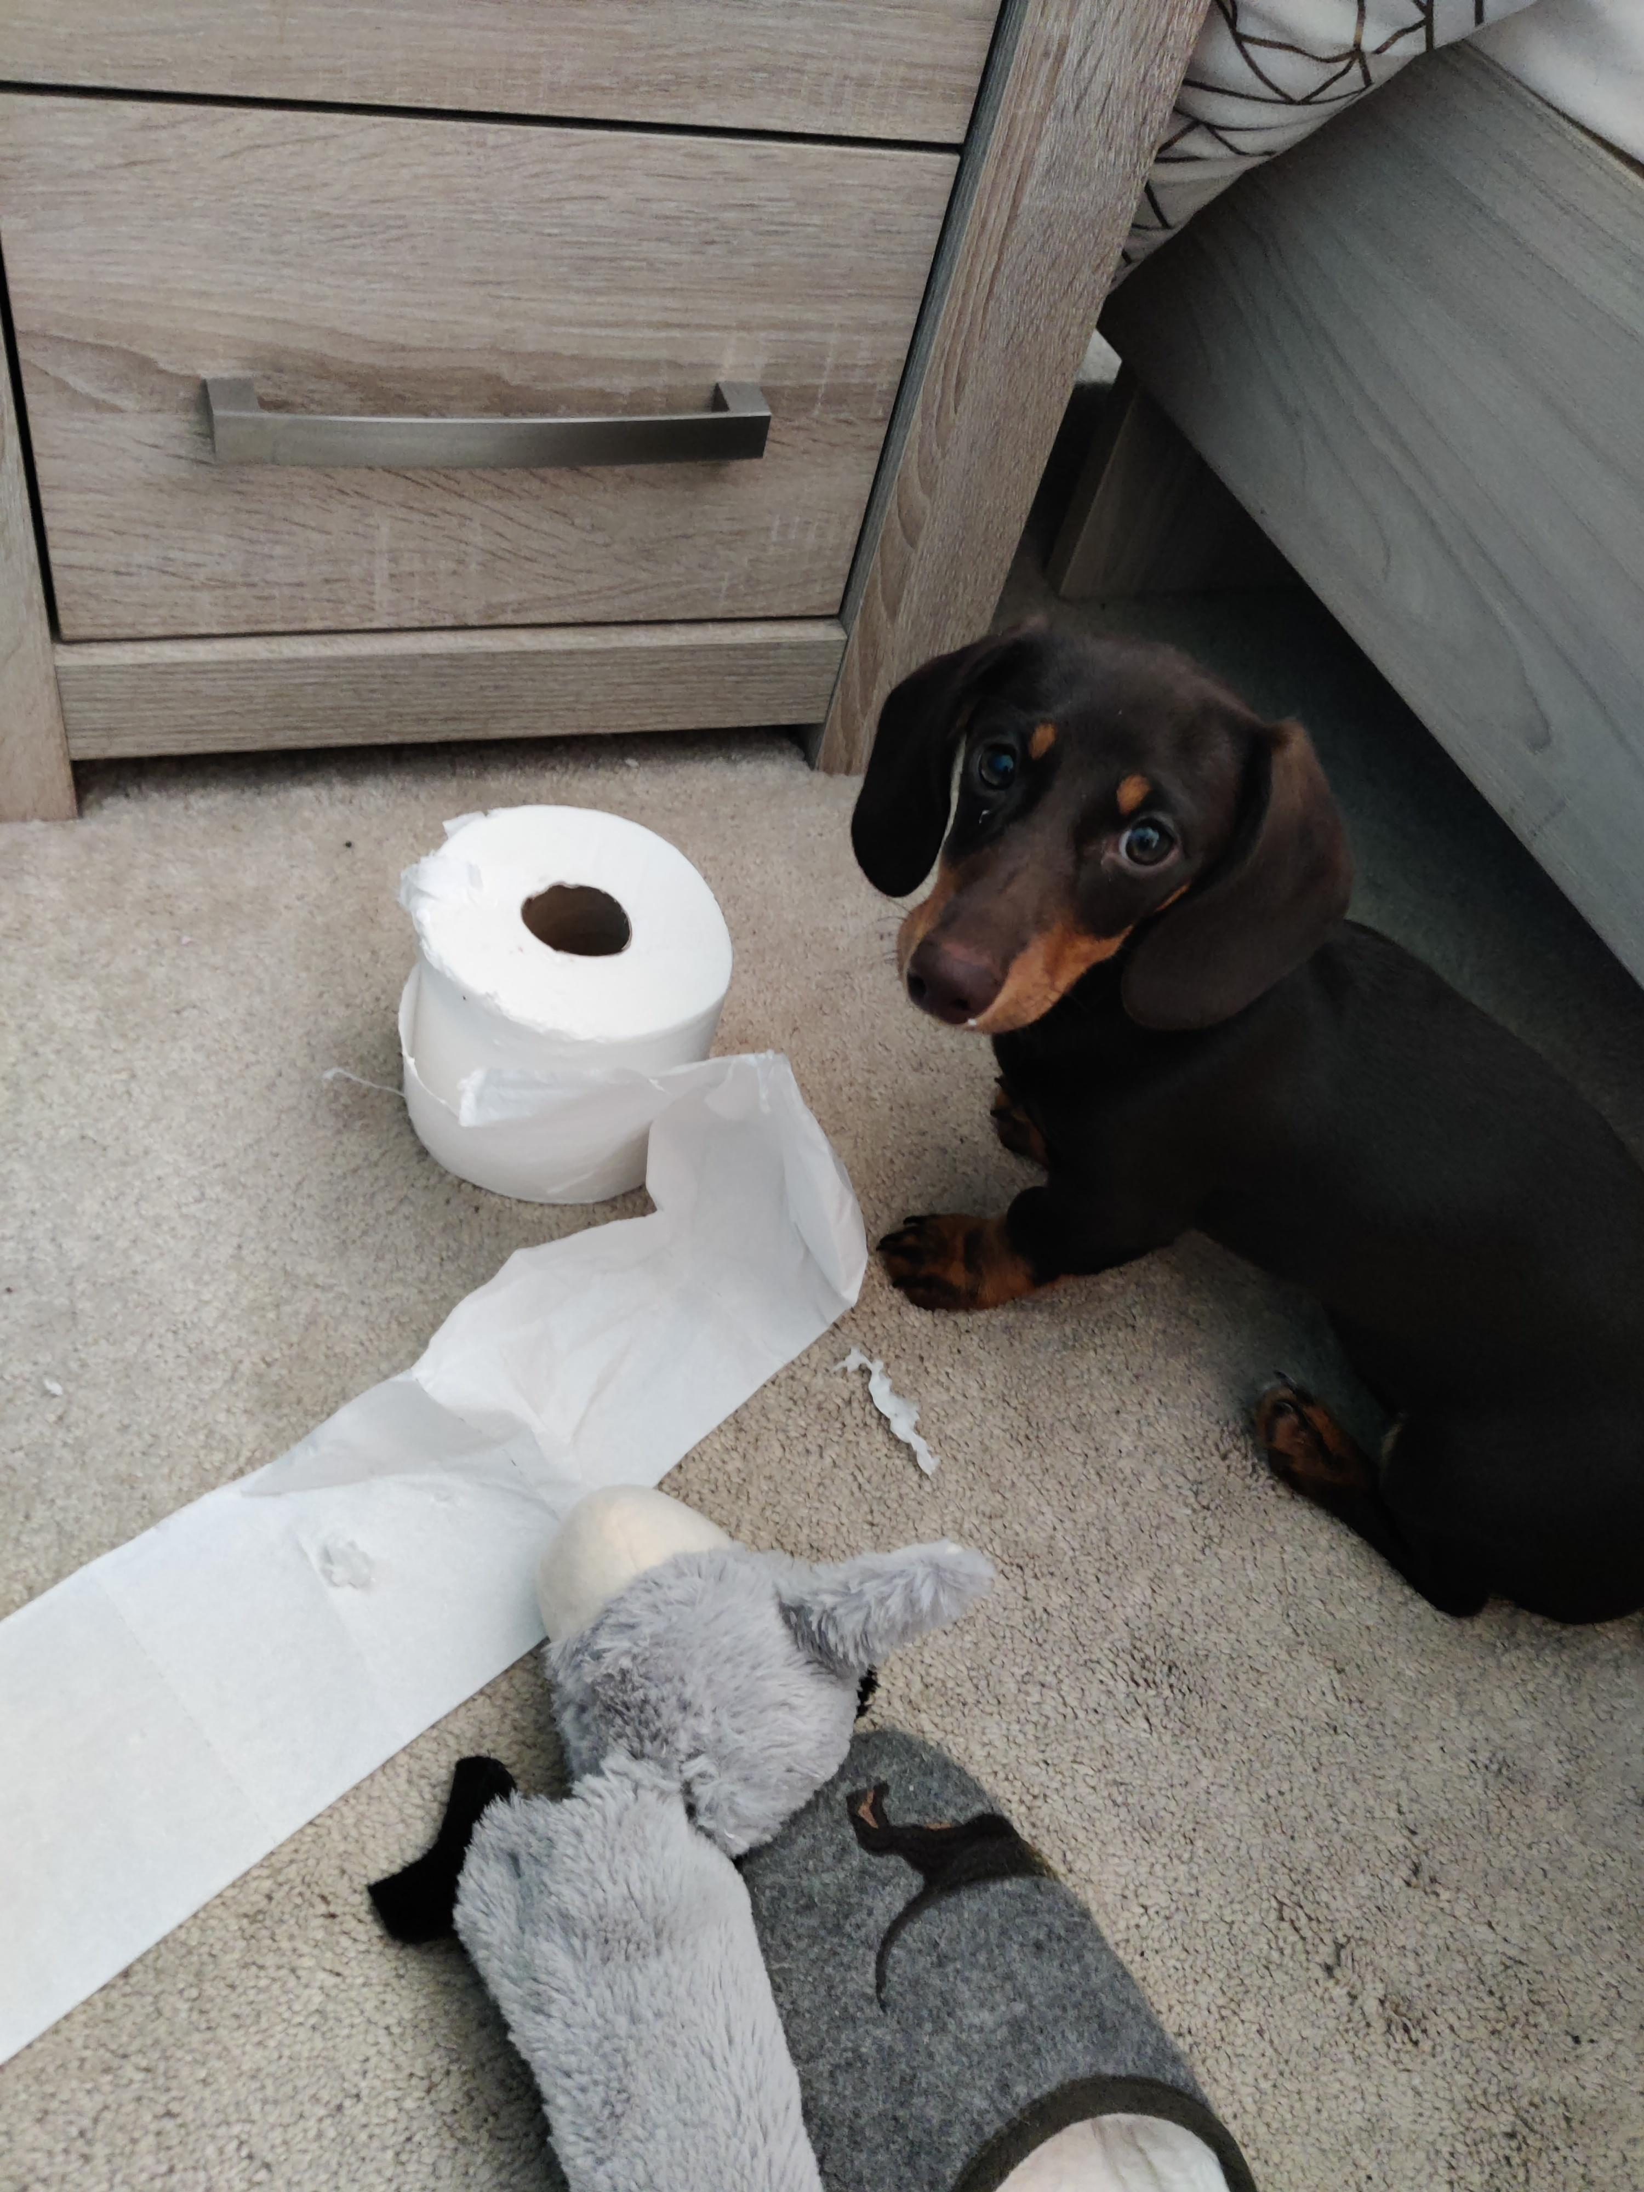
I haven’t always been a well behaved puppy though!
Miss Denyer says it is a good job I’m cute.

Slide 7
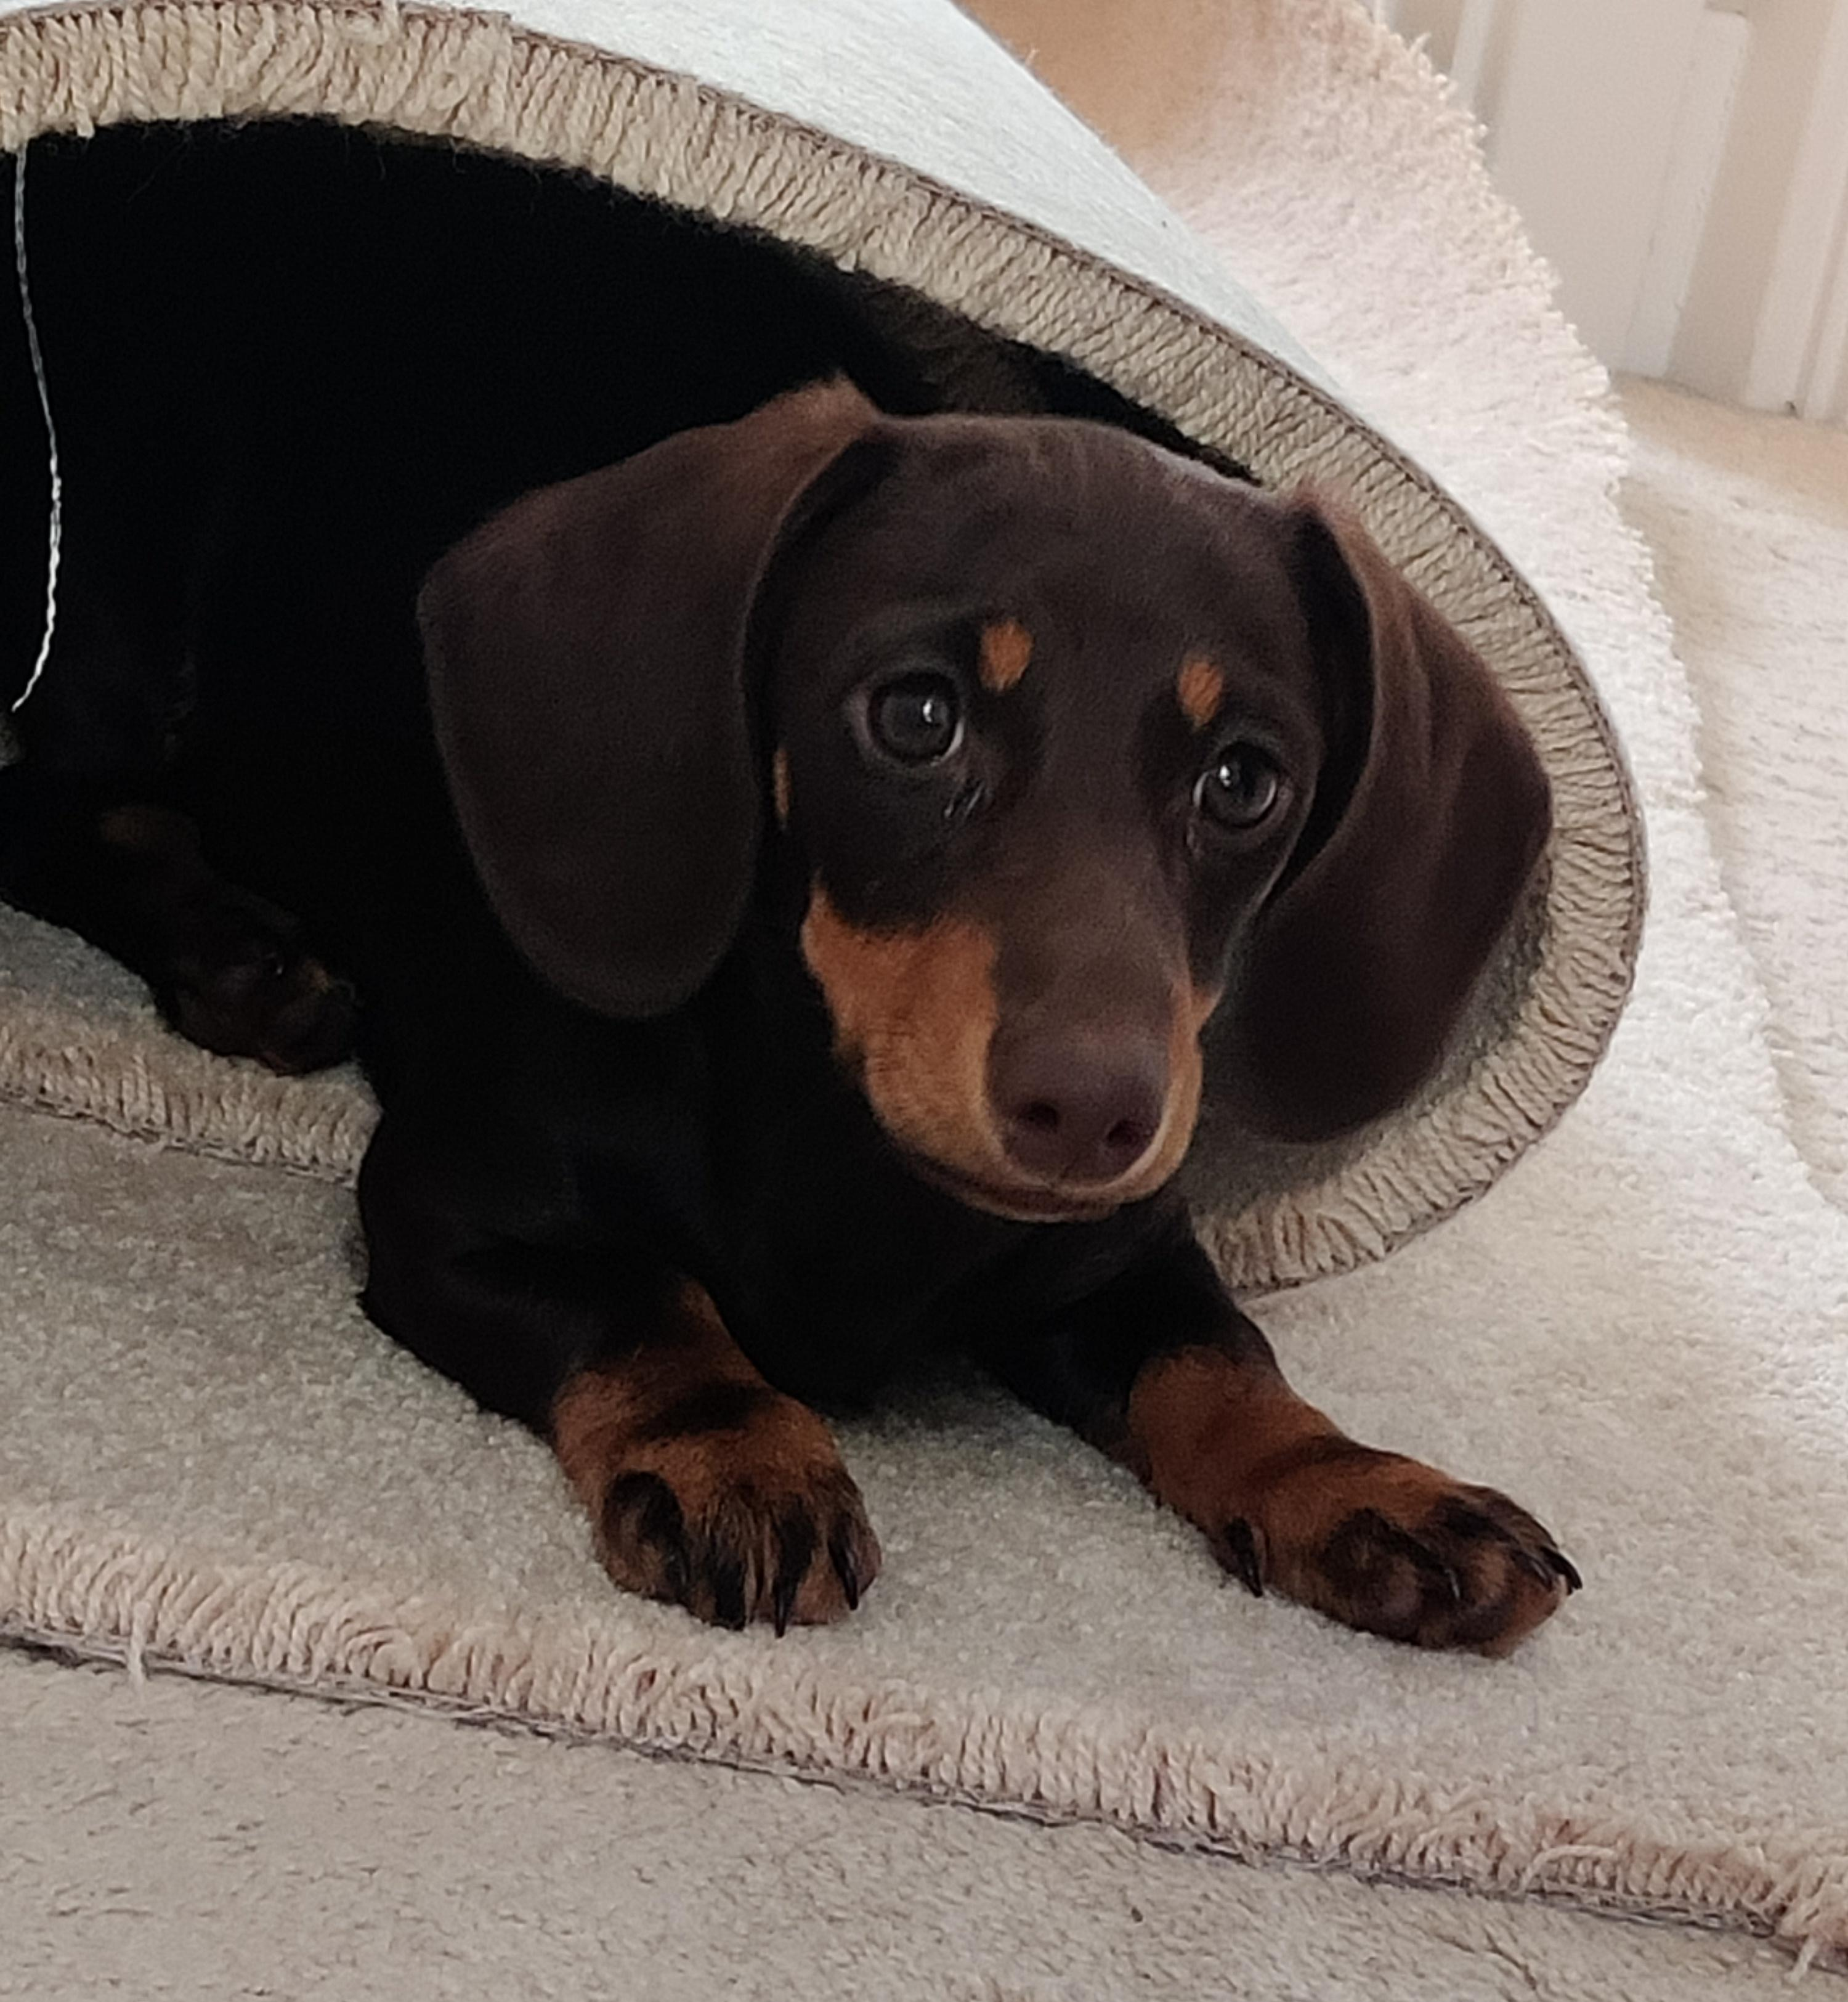
I found a comfy spot in this rolled up carpet. I stayed here for ages even though some pesky humans wanted to move it.
Mrs Pick put me in a tutu. I think this was my punishment for stealing the toilet roll.

Slide 8
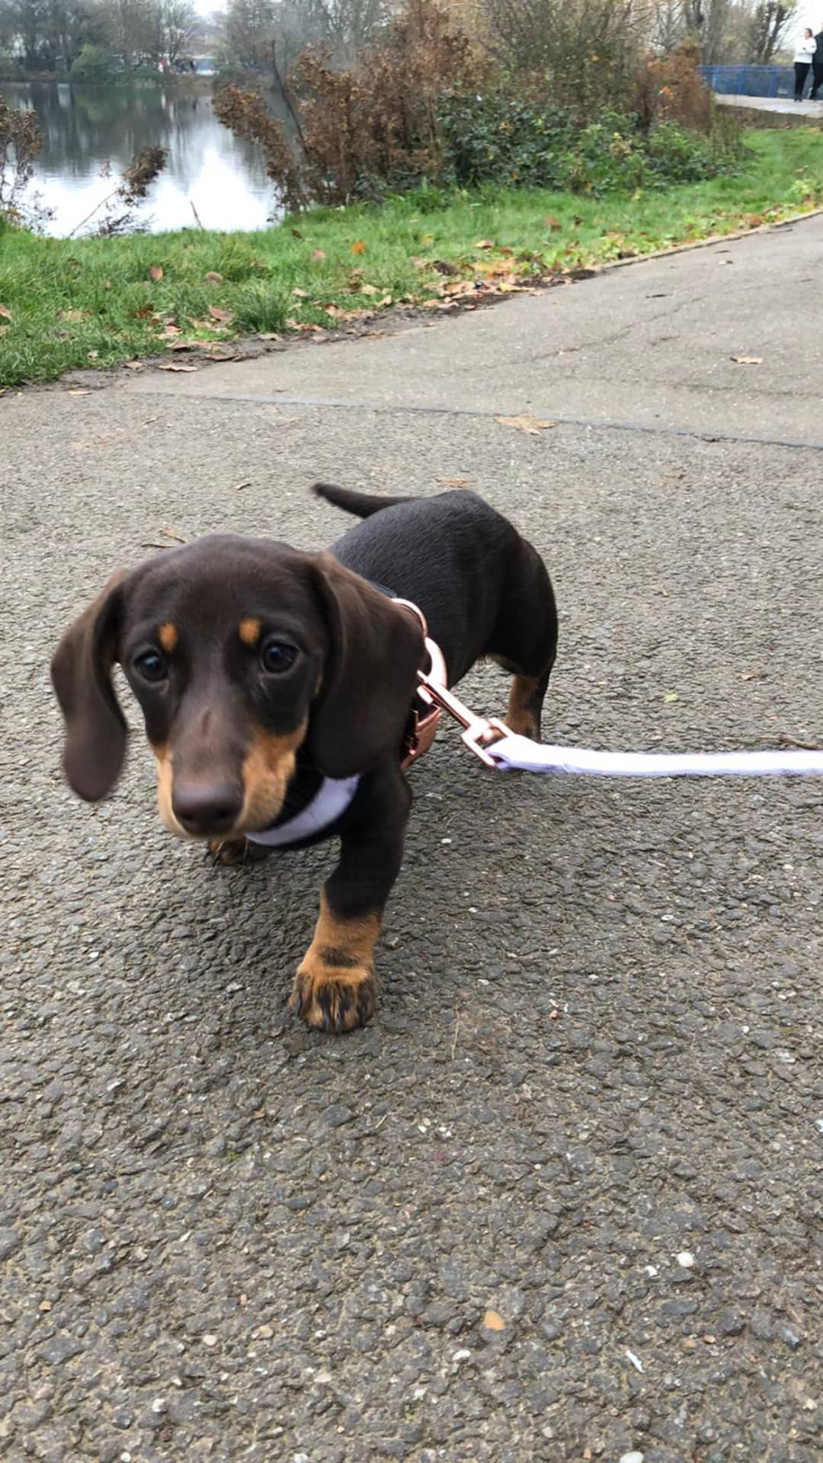
I’ve been such a good girl and really tried hard to walk nicely on my lead. I only lay down when a car goes past now!

Slide 9
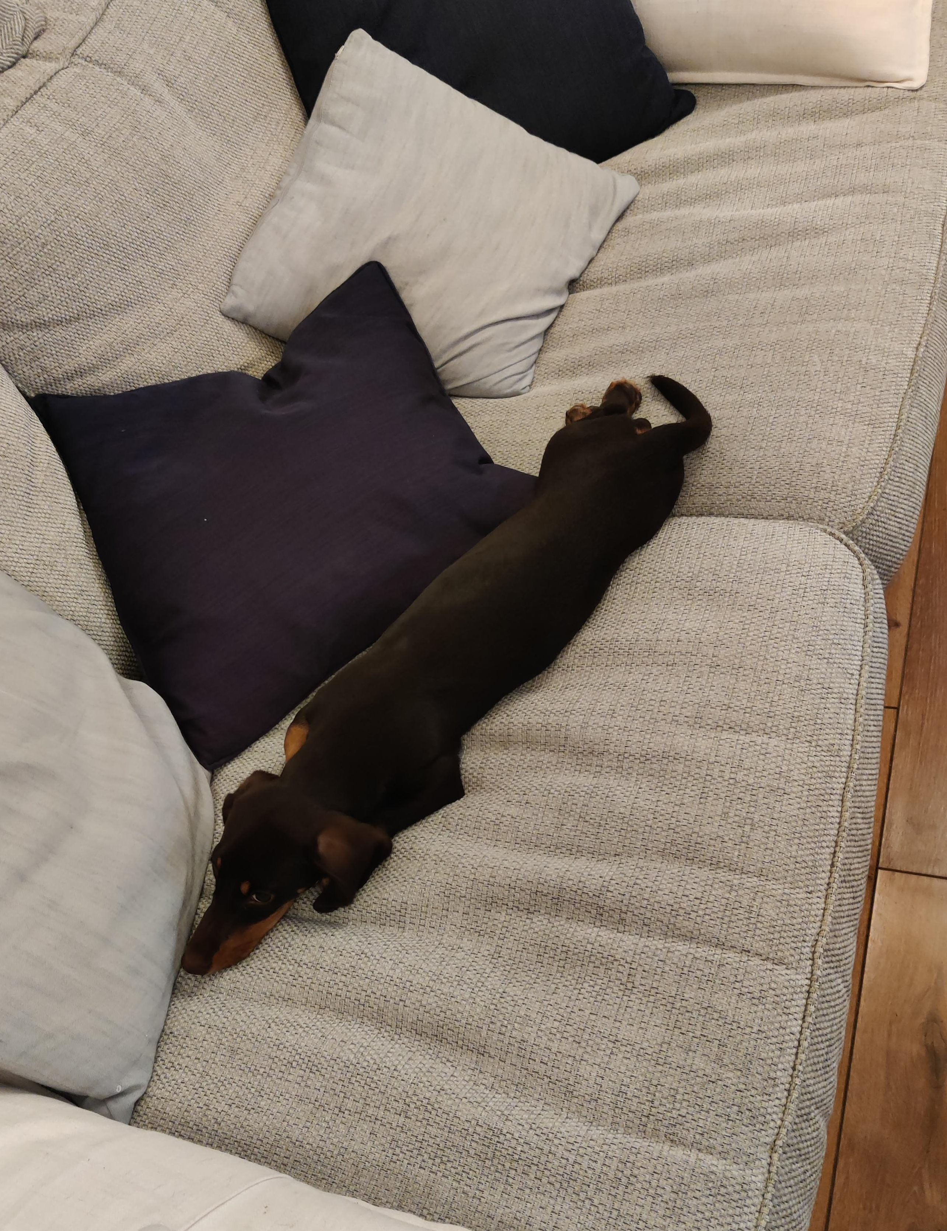
I’ve been working really hard on my growing. I’m getting longer and longer by the day. My lockdown goal is to be able to touch both ends of the sofa when I stretch out.
I lost my first tooth! The puppy tooth fairy came and left me a carrot and some treat-filled ice cubes to chew on because my teeth are a bit sore.

Slide 10
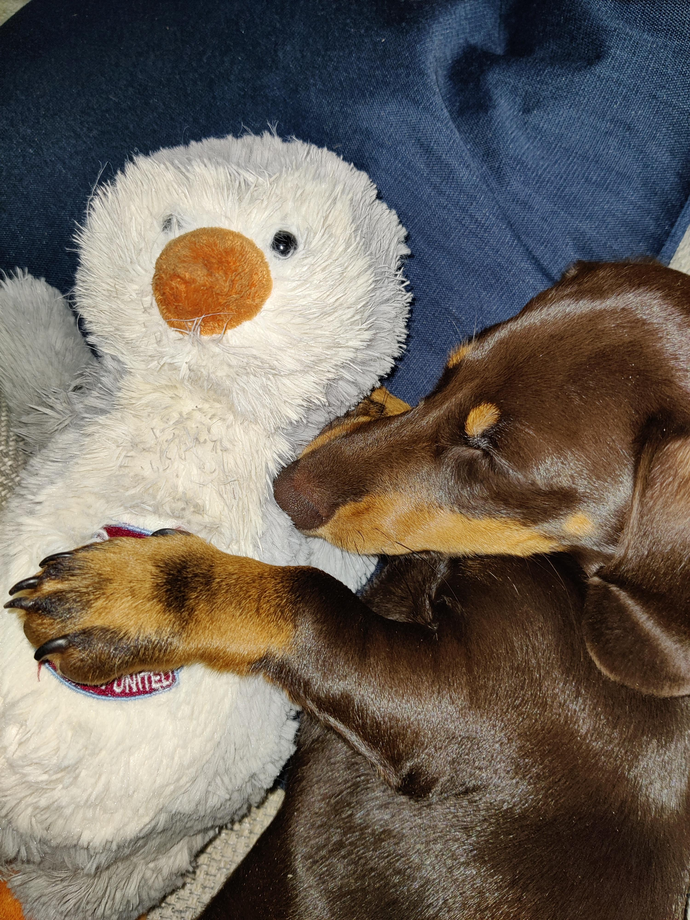
After all that fun I’ve needed quite a few naps on the sofa with my favourite teddy, Jääskeläinen the West Ham penguin.
Miss Denyer lets me sit on her lap while she looks at your work on Dojo and I’m so impressed! You are all working so hard and I can’t wait to hear all about your lockdown adventures when you come back to school.

