Slide 1
Phoneme pronunciation

Slide 2
Click on the sounds to hear the correct pronunciation. Make sure you are viewing in ‘slide show’ mode.

Slide 3
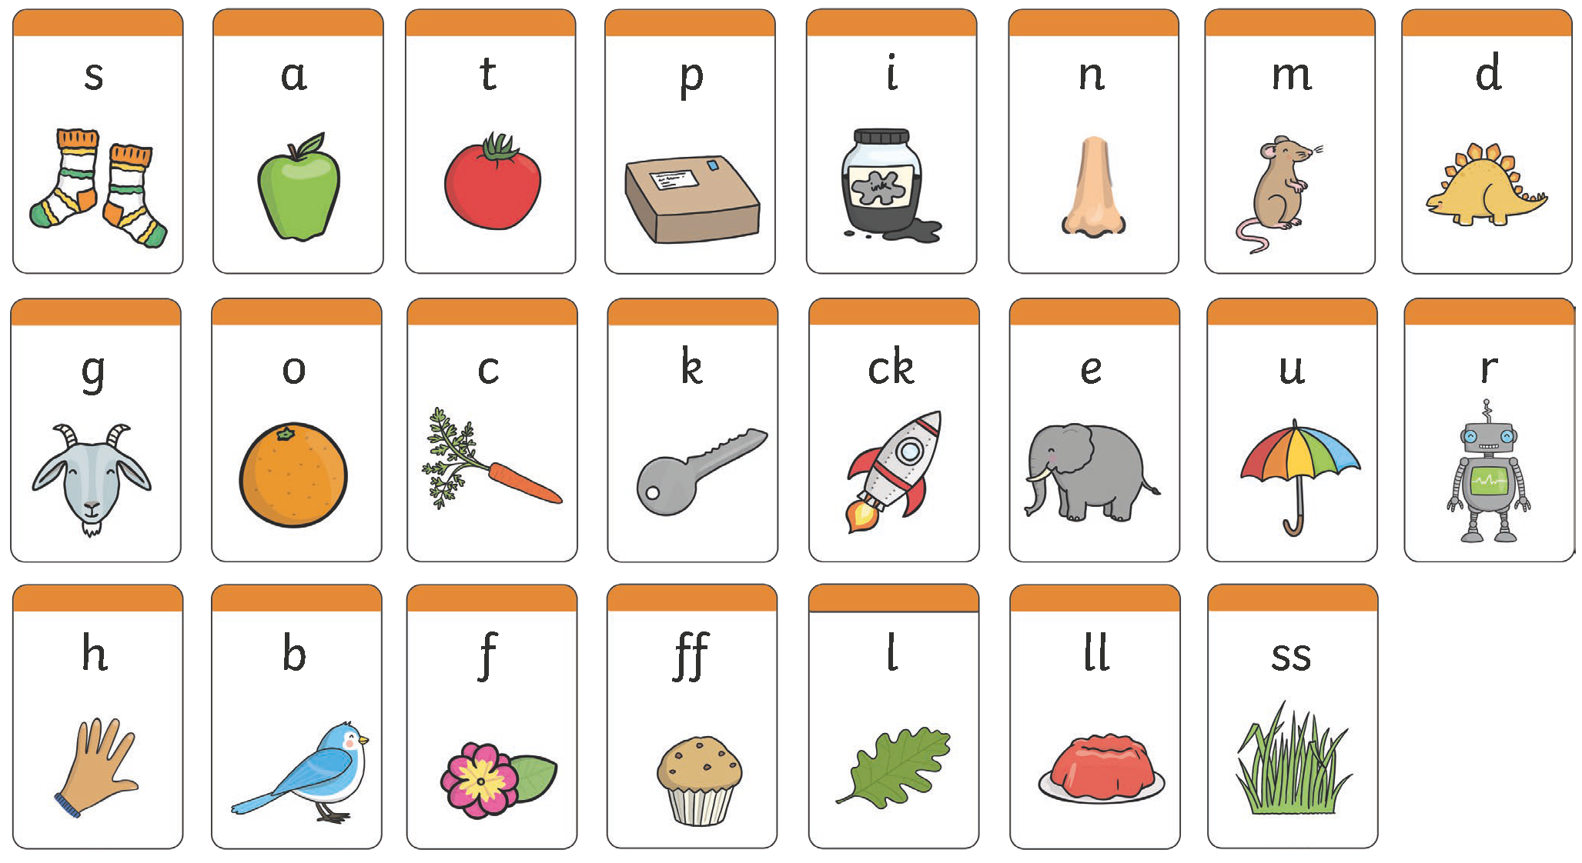
Phase 2 Sound Mat - EYFS
Notes:
Mins the ‘-uh’ t (not ‘tuh’) etc
It’s really important that we as adults model the correct pronunciation of the phonemes and this can be hard when we were taught in a completely different way

Slide 4
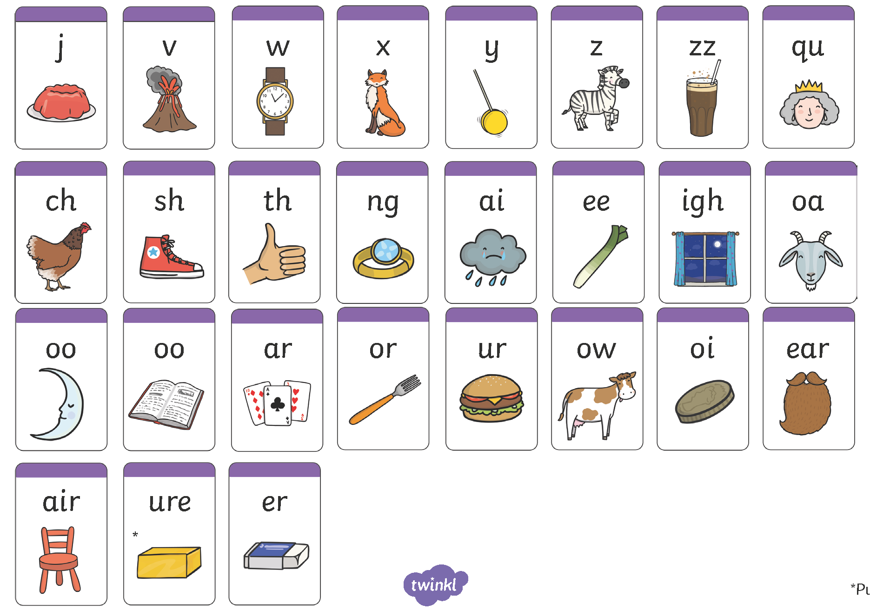
Phase 3 Sound Mat - EYFS

Slide 5
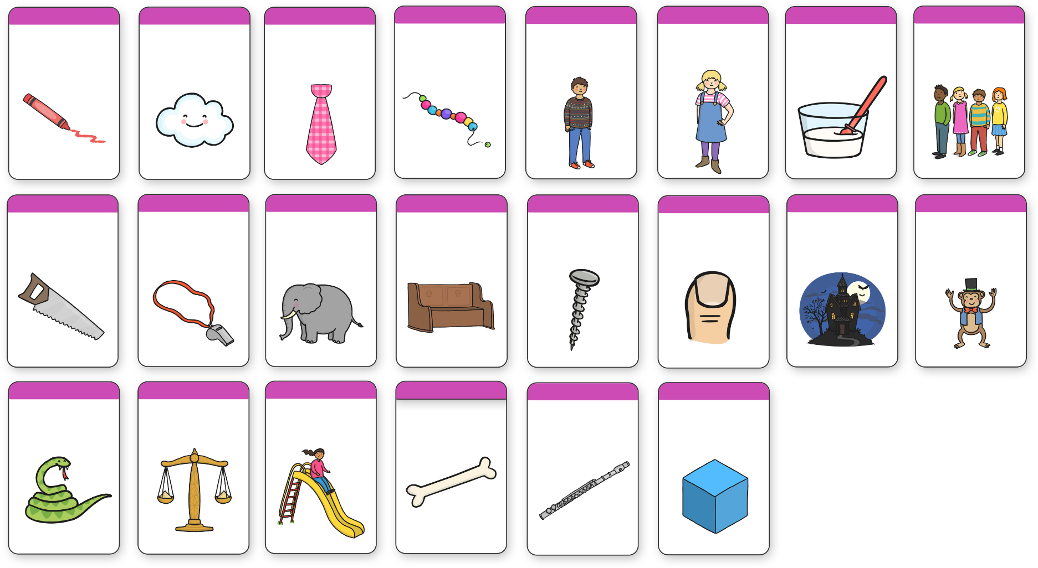
Phase 5 Sound Mat – Y1
ay
ou
ie
ea
oy
ir
ue
ue
aw
wh
ph
ew
ew
oe
au
ey
a-e
e-e
i-e
o-e
u-e
u-e
Notes:
You will have noticed that there is no phase 4 – there are no new sounds introduced in phase 4 but a heavy focus on consonant blends and tricky words
Once the

Slide 6
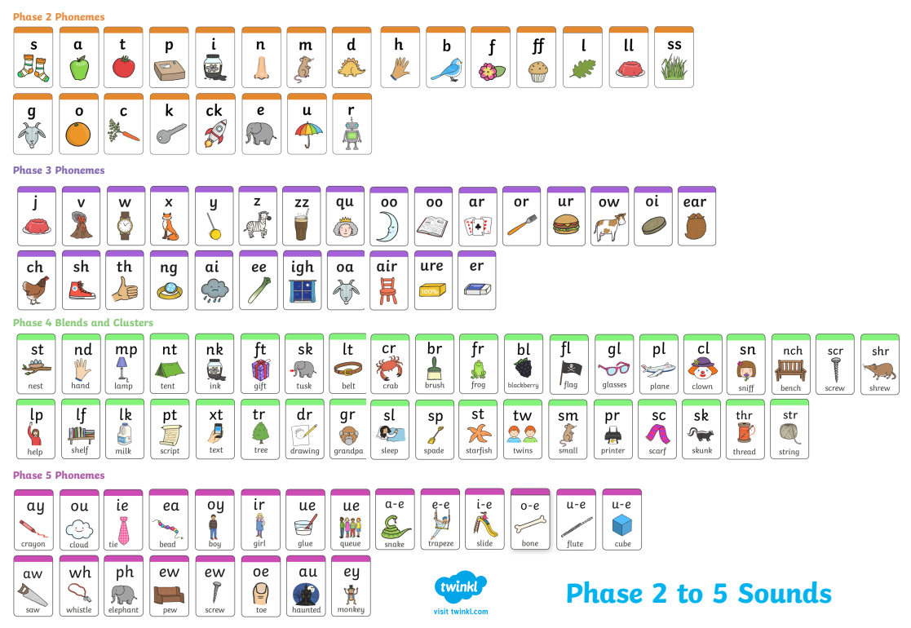
What does it sound like?
Notes:
This is the order in which we teach the phonemes. In EYFS we sometimes teach actions to accompany letter sounds and children learn songs to embed the new learning
S – snake (the snake is in the grass)
A –ants on my arm
T – tennis game (head back and forth ‘t’)
P – puff on the candles on the pink pig cake
I – inky the mouse is my pet
N – nnnnnn (hear the aeroplane)
There are lots of Jolly Phonics songs on youtube that you can watch at home such as…

