Slide 1

Welcome to
Springfield Primary School
Notes:
Jackie

Slide 2
Welcome to our school. As a school we are committed to doing all we can to ensure our children enjoy and achieve during their time at Springfield Primary School and it is our aim that every child should feel that he or she is becoming part of a special community.

Slide 3
Parent Session Overview
Who’s who?
Where can I find information?
Our School Values
Wider school community – PTA and Breakfast club
What do I need for school?
Our learning in EYFS
Preparing for September

Slide 4
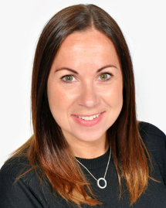
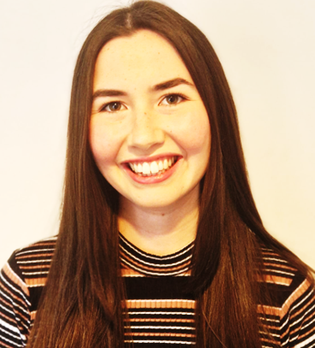
EYFS Team
Hedgehogs
Mrs Jones
Squirrels
Miss Blaney
Mrs Wright
Miss Baldock
Mrs Cox
Mrs Anderton
Miss Georgiou
Mrs Vickers

Slide 5
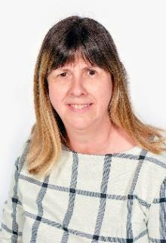
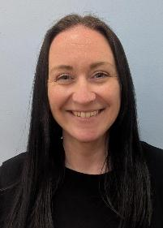
Mrs Kettley
Pastoral Lead
Safeguarding
Wellbeing and parental support
Mrs Hubbard
SENDCo
Learning barriers and difficulties

Slide 6



Where can I find information?
Newsletters emailed to parents weekly
Events
Diary dates
Celebrations
Reminders
Menu
School Website
www.springfield-pri.essex.sch.uk
@SpringfeldPri2
Notes:
Tapestry details emailed at the beginning of term – paper forms available

Slide 7

Our Learning Values
Children can earn stickers by displaying behaviours linked to each of the school values.

Slide 8
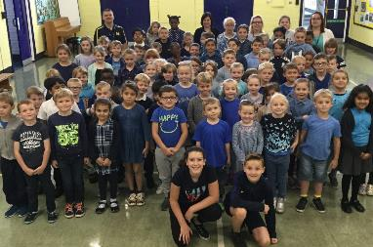
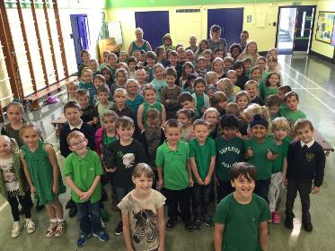
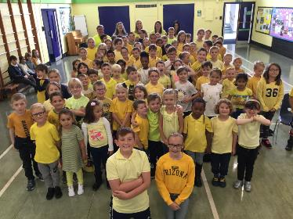
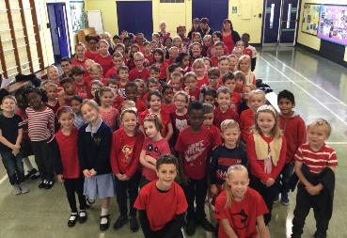
The children are in four houses:
Malala House
Earps House
Attenborough House
Siblings are in the same house.
Farah House

Slide 9
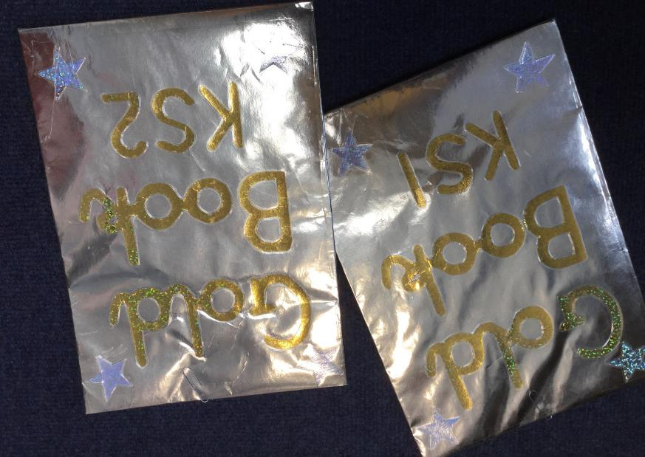
Achievements go in the Gold Book and are shared in our weekly Celebration Assemblies

Slide 10
Behaviour at Springfield
Be ready
Be Respectful
Be kind
Notes:
Our behaviour is centred around celebrating the positive and supporting children to be reflective, considerate citizens

Slide 11
Breakfast & After School Clubs
Open from 8am and until 6pm
Run by our own school staff and are very popular.
Please contact the office for further details.
Notes:
Forms available

Slide 12

PTA
The PTA are a group of parent and teacher volunteers who:
Organise and run events to raise money for the school
Donate funds for class trips, discos and fun events for the children
Anyone can join to be on the committee or be a parent helper at our events
News is advertised in the weekly school newsletter and on our Facebook page

Slide 13
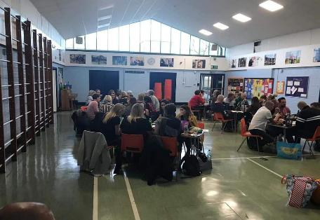
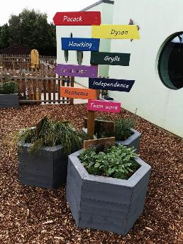

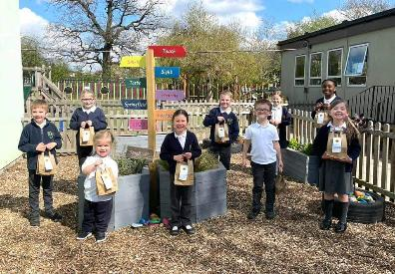
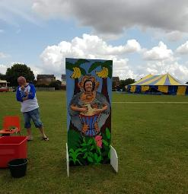



Slide 14
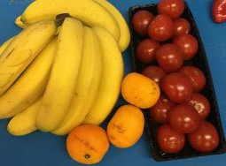
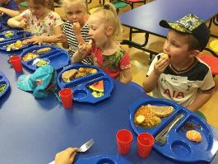
School Meals and Payments
Children in EYFS, Year 1 and 2 are entitled to universal free school meals and a healthy snack.
Do not send snack in.
We are a cash free school so payments for dinner money or trips etc are made online
Please inform us of any food allergies or dietary requirements

Slide 15
Getting ready for school
Notes:
Useful information on TLC website information in pack

Slide 16
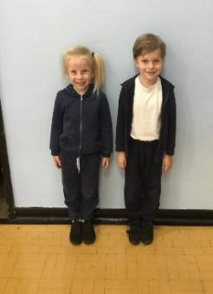
Uniform and PE Kit
LABEL EVERYTHING
Uniform: white shirt/polo, navy jumper/cardigan, grey trousers/skirt/pinafore dress, grey tights, white socks
Black shoes –Velcro please!
PE kit: white t-shirt, navy shorts, suitable footwear (trainers or plimsolls), navy joggers and top in cooler weather.
No jewellery at school except stud earrings and watches (no earrings on PE days)
Long hair tied back daily
School branded uniform and PE kit is available to order from https://www.onestopschoolgear.com/

Slide 17
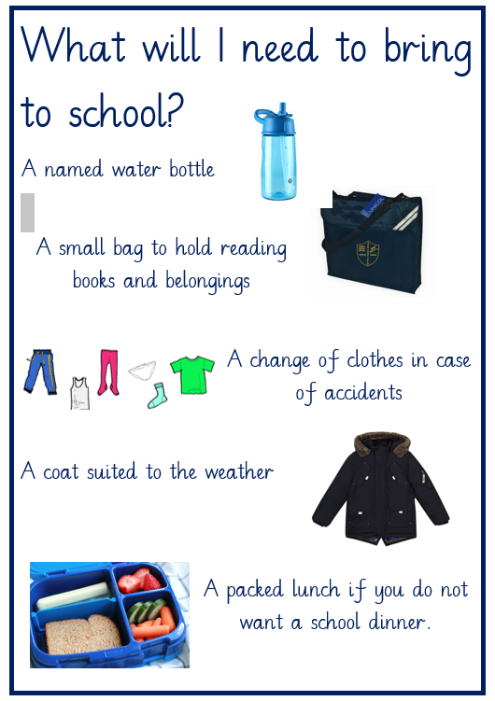

Slide 18
Our Learning

Slide 19
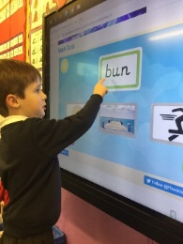
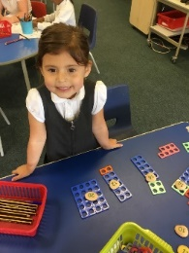
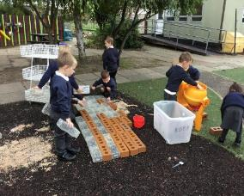
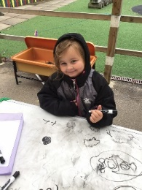
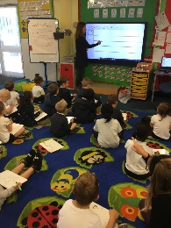
A day in EYFS
8.40-3.10
Phonics & Maths every morning
Child led learning activities (indoors and outdoors)
Adult led learning
Assembly
Social snack
Playtime
Singing and story times
PE once a week
Notes:
Carole
8.40-8.55: children begin learning as soon as they arrive. They work on table activities that have been set up for them to access independently or with some support
Self-registration to encourage independence
Phonics taught daily

Slide 20
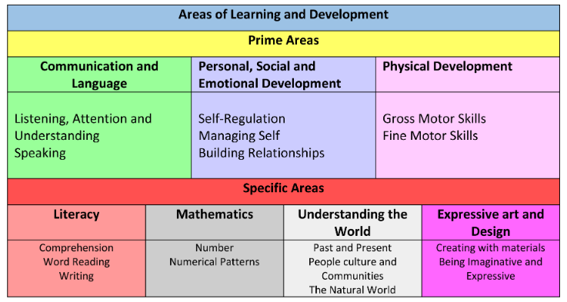
Our Curriculum
Notes:
Carole

Slide 21
Being Ready To Learn
In the Early Years Foundation Stage (EYFS), self-regulation and executive functioning are critical, overlapping skills that allow children to manage their emotions, control impulses, and focus on tasks.
These prime skills form the foundation for academic success and healthy personal development

Slide 22
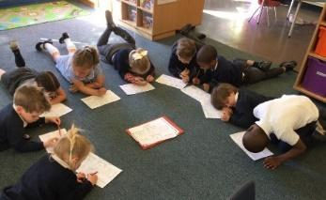
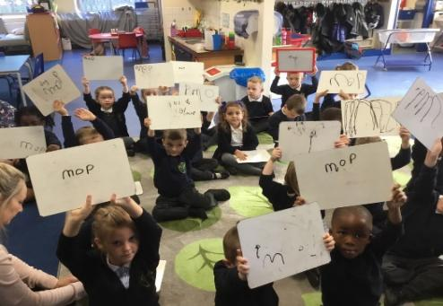
Phonics
Bug club
Supports early development of reading and writing
Starts with individual letter sounds
Further support with using at home in September
Letter names are important too!
Notes:
Carole Jones
Phonics pictures to add in

Slide 23
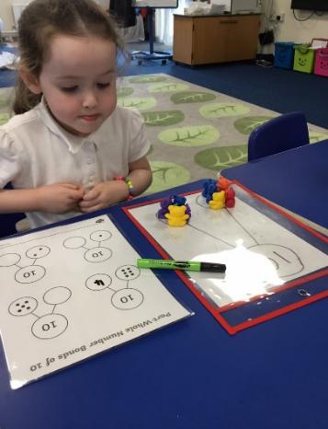
Maths
Counting songs
Understanding 5
Counting things 1:1
Recognising numbers

Slide 24
Handwriting
Nip, flip and grip
Sassoon font for clear, legible handwriting.
a b c d e f g h i j k l m n o p q r s t u v w x y z
Notes:
Carole

Slide 25
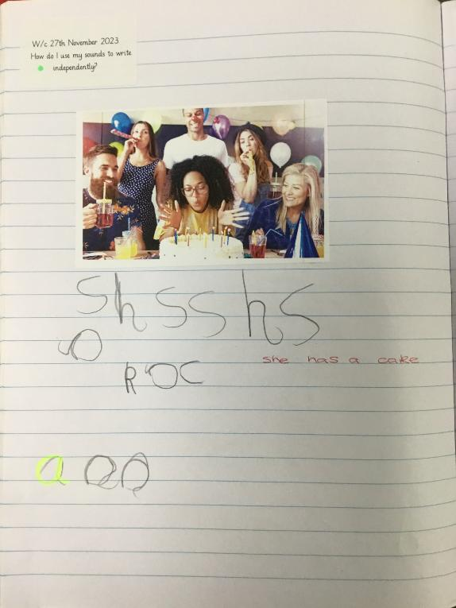
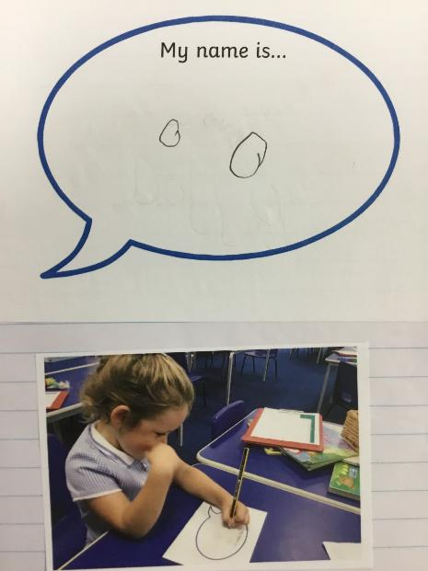

Slide 26
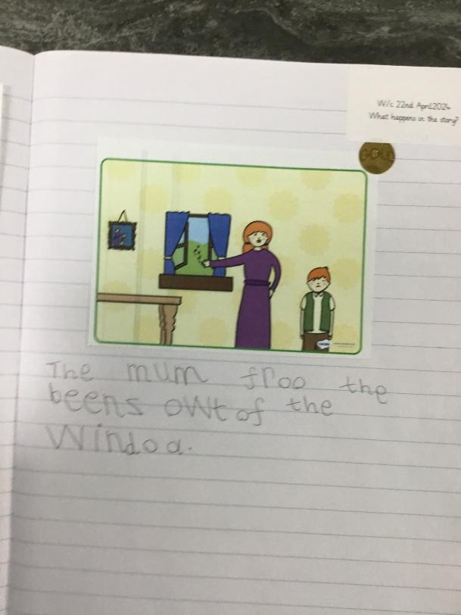
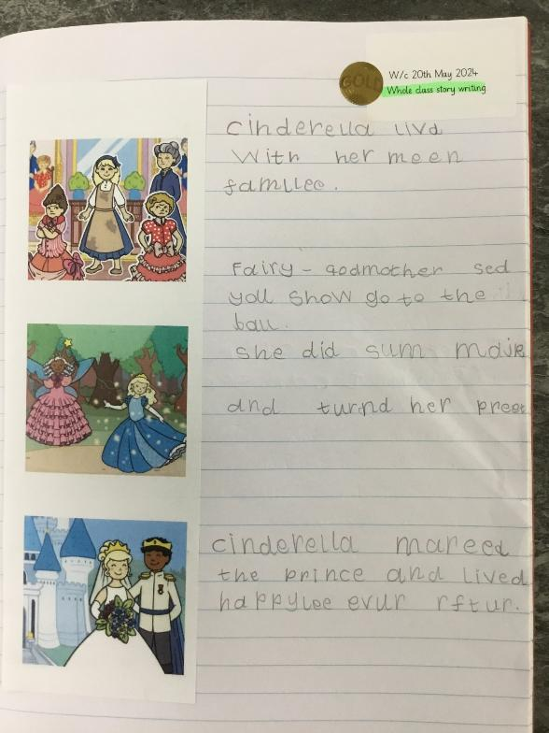

Slide 27
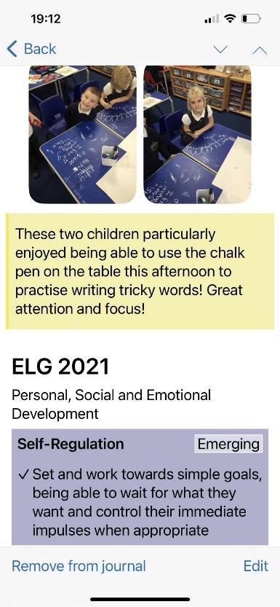

We use Tapestry in EYFS to share with parents what the children have been doing in school.
Parents can also share things with us via Tapestry.
Notes:
Tapestry APP – More information in September. Children need to be on roll to have an account

Slide 28
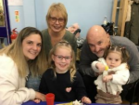
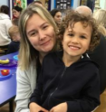
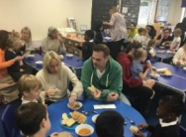
When will you see their work?
Throughout the year we invite families to see their children’s learning (e.g. Harvest food tasting, Christmas crafts, afternoon tea around spring time, Oracy open sessions and Phonics sessions.
You will have a chance to see children’s books at parents evening.
Notes:
Tapestry APP – More information in September. Children need to be on roll to have an account

Slide 29
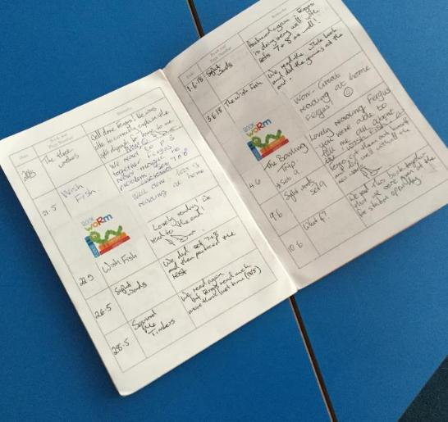

Reading at Home
Please listen to your child read at home, ideally at least 4 times.
Regular reading is rewarded
We send books home weekly but there is access to online books through Bug Club
Notes:
Reading parents workshops in the autumn term with Mrs Esser

Slide 30
Our Aims
To work in partnership with parents and carers to encourage independent, happy learners who thrive in school and reach their full potential from their various starting points.
To understand and follow children’s interests and provide opportunities throughout our EYFS curriculum to support learning, consolidate and deepen knowledge and ensure children meet their next steps.
To create an indoor and outdoor environment which supports learning.
To prepare children to reach the Early Learning Goals at the end of the Foundation Stage and ensure children make good progress from their starting points.
To support transition into KS1

Slide 31
What’s next?

Slide 32
Is there anything we need to know?
Fill in and return your new starter pack if you haven’t already.
Disabilities or learning difficulties (however minor you may feel they are). Please see your GP if you have any concerns about your child’s development
Religious beliefs (especially if these affect your child’s dietary requirements)
Medical needs
Other languages spoken at home
Pupil Premium Entitlement - funding helps us provide your child with resources to support their learning
Preferred/alternative names
If there is anyone who isn’t allowed to collect your child from school (safeguarding)
Notes:
Kelly

Slide 33
How to prepare your child for school
Don’t stress too much about the academics
Focus on personal independence - toileting is extremely important including wiping
Can your child dress themselves, use cutlery, take their shoes/socks off, hang their coat/bag up?
Taking turns and sharing
Try to reduce/limit screen time to support attention levels
Notes:
Kelly

Slide 34
How to prepare your child for school
If your child is nervous about school, acknowledge their feelings and keep the conversation positive
Share your transition pack regularly with your child throughout the holidays
Allow your child to try on their uniform and role play with their new items
Notes:
Kelly

Slide 35
September 2026 Timetable for New Starters
Wednesday 2nd September Thursday 3rd September 9-11am | Monday 7th September Tuesday 8th September 8.40-1.15pm (includes lunch)
Friday 4th September 8.40-11.45am | Wednesday 9th September 8.40-3.10pm Full Time

Slide 37
Meet and Mingle Picnic
Tuesday 7th July 11-12pm In the EYFS outdoor classroom
Bring a picnic rug and packed lunch (NO NUTS PLEASE)
It’s an opportunity for you and your child to meet with other families.
The children will find out their class and meet their teachers.

